Slide 1
Positional Number Systems
CSCE 210: Computer Hardware Foundations
Professor Matt Thatcher

Slide 2
Start Recording

Slide 3
Last Class
Course Administration
  Course website (Blackboard)
    https://blackboard.sc.edu
Introduction to Computer Architecture
  Hardware
    I/O devices, storage devices, CPU, memory
  Software
    Application software vs. systems software (OS)
  Data
    Fundamental representation of facts and observations
  Communications
    Sharing data and processing among different systems and subsystems

Slide 4
Required Viewing
(BB > Recordings > An Overview of Computer Systems)
What is a system?
  Definition
  Decomposition
  Abstraction
IT system architectures
  Distributed processing systems
    Client-Server Computing
      Two-tier architecture
      Three-tier architecture
      N-tier architecture
    Web-Based Computing
    Cloud Computing
    Peer-to-Peer Computing

Slide 5
Today’s Agenda
Number Systems
  Decimal
  Binary
  Octal
  Hexadecimal
Converting among the different number systems

Slide 6
Counting and Arithmetic
Decimal or base 10 number system
  Origin: counting on the fingers
  “Digit” from the Latin word digitus meaning “finger”
Base
  The number of different symbols, including zero, in the number system
    Base 10 (decimal) has 10 symbols - 0 through 9
    Base 2 (binary) has 2 symbols - 0 and 1
    Base 8 (octal) has 8 symbols - 0 through 7
    Base 16 (hexadecimal) has 16 symbols - 0-9 and A-F

Slide 7

Why Binary?
Early computer design was decimal
  Mark I and ENIAC
John von Neumann proposed binary data processing (1945)
  Simplified computer design
  Used for both instructions and data
Natural relationship between
on/off switches and
calculations using Boolean logic
On | Off
True | False
Yes | No
1 | 0

Slide 8
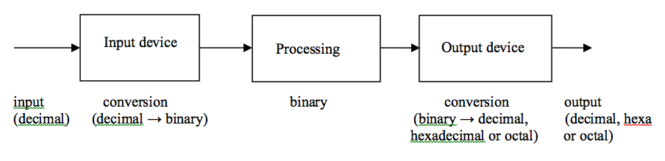
Why Octal and Hex?
  Why octal and hexadecimal?
  Octal and hex are easier (fewer digits) to read and write than binary
  Modern computer operating systems and networks present a variety of troubleshooting data in octal and hex formats
  Some programs represent colors using hex formats

Slide 9
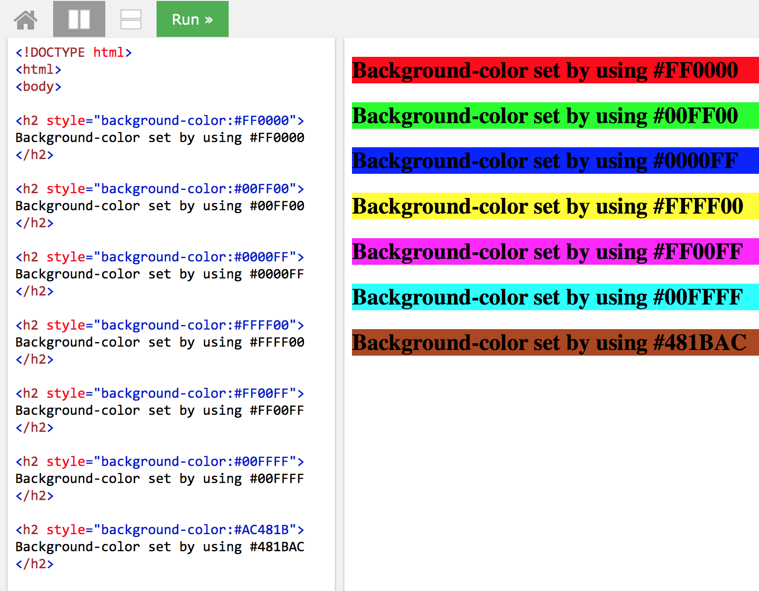
Notes:
http://www.w3schools.com/html/tryit.asp?filename=tryhtml_colorhex

Slide 10
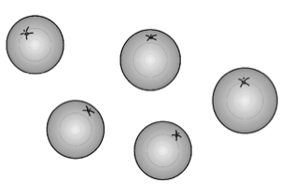
Numbers
(Physical Representation)
Different numerals, same number of oranges
  Cave dweller: IIIII
  Roman: V
  Arabic: 5
Different bases, same number of oranges
  5₁₀
  101₂
  12₃

Slide 11
Number Systems
Modern number systems are based on positional notation (place value)
  Decimal system: based on powers of 10
    1’s place: 10⁰
    10’s place: 10¹
    100s place: 10²
    1000’s place: 10³
    And so on…
  Binary system: based powers of 2
    1’s place: 2⁰
    2’s place: 2¹
    4’s place: 2²
    And so on…
  Octal system: based on powers of 8
  Hexadecimal system: based powers of 16

Slide 12
Different Number Bases
Base
  The number of different symbols required to represent any given number
The larger the base, the more symbols are available
  Base 10: 0, 1, 2, 3, 4, 5, 6, 7, 8, 9
  Base 2: 0, 1
  Base 8: 0, 1, 2, 3, 4, 5, 6, 7
  Base 16: 0, 1, 2, 3, 4, 5, 6, 7, 8, 9, A, B, C, D, E, F

Slide 13
Positional Notation
(Decimal - Base 10)
254₁₀ = 2 x 10² + 5 x 10¹ + 4 x 10⁰
100’s place
10’s place
1’s place
Most Significant Position
Least Significant Position
Place | 10² | 10¹ | 10⁰
Value | 100 | 10 | 1
Evaluate | 2 x 100 | 5 x 10 | 4 x1
Sum | 200 | 50 | 4

Slide 14
Positional Notation
(Decimal - Base 10)
245₁₀ = 2 x 10² + 4 x 10¹ + 5 x 10⁰
100’s place
10’s place
1’s place
Most Significant Position
Least Significant Position
Place | 10² | 10¹ | 10⁰
Value | 100 | 10 | 1
Evaluate | 2 x 100 | 4 x 10 | 5 x1
Sum | 200 | 40 | 5
254₁₀ (last slide) is different from 245₁₀ (this slide)
  Because the digits sit in a different place value position

Slide 15
Binary – Base 2
(Convert Binary to Decimal)
(11010110)₂ = 1(2⁷)+1(2⁶)+0(2⁵)+1(2⁴)+0(2³)+1(2²)+1(2¹)+0(2⁰)
= (214)₁₀
128’s place
32’s place
8’s place
2’s place
64’s place
16’s place
4’s place
1’s place
MSP
LSP
Place | 2⁷ | 2⁶ | 2⁵ | 2⁴ | 2³ | 2² | 2¹ | 2⁰
Value | 128 | 64 | 32 | 16 | 8 | 4 | 2 | 1
Evaluate | 1 x 128 | 1 x 64 | 0 x 32 | 1 x16 | 0 x 8 | 1 x 4 | 1 x 2 | 0 x 1
Sum for Base 10 | 128 | 64 | 0 | 16 | 0 | 4 | 2 | 0

Slide 16
Binary – Base 2
(Convert Binary to Decimal)
(101101)₂ = (45)₁₀
= 1(2⁵) + 0(2⁴) + 1(2³) + 1(2²) + 0(2¹) + 1(2⁰)
= 1(32) + 0(16) + 1(8) + 1(4) + 0(2) + 1(1)
= 32 + 0 + 8 + 4 + 0 + 1
= 45₁₀

Slide 17
Octal – Base 8
(Convert Octal to Decimal)
(624)₈ = 6(8²) + 2(8¹) + 4(8⁰)
= 6(64) + 2(8) + 4(1)
= 384 + 16 + 4
= (404)₁₀
64’s place
8’s place
1’s place
Place | 8² | 8¹ | 8⁰
Value | 64 | 8 | 1
Evaluate | 6 x 64 | 2 x 8 | 4 x 1
Sum for Base 10 | 384 | 16 | 4

Slide 18
Octal – Base 8
(Convert Octal to Decimal)
(1263)₈ = (691)₁₀
= 1(8³) + 2(8²) + 6(8¹) + 3(8⁰)
= 1(512) + 2(64) + 6(8) + 3(1)
= 512 + 128 + 48 + 3
= 691₁₀

Slide 19
Hexadecimal – Base 16
(Convert Hexa to Decimal)
(6704)₁₆ = 6(16³) + 7(16²) + 0(16¹) + 4(16⁰ )
= 6(4096) + 7(256) + 0(16) + 4(1)
= 24576+ 1792 + 0 + 4
= (26372)₁₀
4,096’s place
256’s place
16’s place
1’s place
Place | 16³ | 16² | 16¹ | 16⁰
Value | 4,096 | 256 | 16 | 1
Evaluate | 6 x 4,096 | 7 x 256 | 0 x 16 | 4 x 1
Sum for Base 10 | 24,576 | 1,792 | 0 | 4

Slide 20
Hexadecimal – Base 16
(Convert Hexa to Decimal)
(3DA6B)₁₆ = (252523)₁₀
= 3(16⁴) + 13(16³) + 10(16²) + 6(16¹) + 11(16⁰)
= 3(65536) + 13(4096) + 10(256) + 6(16) + 11(1)
= 196,608 + 53,248 + 2,560 + 96 + 11
= 252523₁₀
Remember that in hexadecimal the interpretation is:
A=10, B=11, C=12, D=13, E=14, F=15

Slide 21
Number of Symbols vs.
Number of Digits
For a given number, the larger the base
  The more symbols available
  But the fewer digits needed
Example 1
  65₁₆ = 101₁₀ = 145₈ = 110 0101₂
Example 2
  DEF₁₆ = 3567₁₀ = 6757₈ = 1101 1110 1111₂
Notes:
Note: I break binary into groups of 4 bits to improve readability

Slide 22
Range of Possible Numbers
(You Will See This on Test 1 – Remember This)
R = B^{K}
  R = range
  B = base
  K = number of digits
Example 1: Base 10, 2 digits
  R = 10² = 100 different numbers
  [0…99] – range of unsigned integers
Example 2: Base 2, 16 digits
  R = 2¹⁶ = 65,536 different numbers
  [0…65535] – range of unsigned integers (in decimal equivalent)
Summary
  B^{K} = Number of different unsigned integer values a k digit # can represent
  [0…B^{k}-1] = Range of unsigned integers that can be represented (min/max)

Slide 23
More Conversions
(Consider the Following:
This May Help Us Understand the Next Slides)
Base 10 | (3422)₁₀
 | IQ | R
3422 / 10 ) | 342 | ( 2 how many 1’s
342 / 10 ) | 34 | ( 2 how many 10’s
34 / 10 ) | 3 | ( 4 how many 100’s
3 / 10 ) | 0 | ( 3 how many 1000’s
Base 10 |  | (3422)₁₀
Remainder
Integer Quotient

Slide 24
Convert Base 10 to Base 2
Base 10 | (42)₁₀
 | IQ | R
42 / 2 ) | 21 | ( 0 Least significant bit
21 / 2 ) | 10 | ( 1
10 / 2 ) | 5 | ( 0
5 / 2 ) | 2 | ( 1
2 / 2 ) | 1 | ( 0
1 / 2 ) | 0 | ( 1 Most significant bit
Base 2 |  | (101010)₂
Remainder
Integer Quotient
Check: (101010)₂=1(2⁵)+0(2⁴)+1(2³)+0(2²)+1(2¹)+0(2⁰)=(42)₁₀

Slide 25
Convert Base 10 to Base 2
Base 10 | (57)₁₀
 | IQ | R
57 / 2 ) | 28 | ( 1 Least significant bit
28 / 2 ) | 14 | ( 0
14 / 2 ) | 7 | ( 0
7 / 2 ) | 3 | ( 1
3 / 2 ) | 1 | ( 1
1 / 2 ) | 0 | ( 1 Most significant bit
Base 2 |  | (111001)₂
Check: (111001)₂=1(2⁵)+1(2⁴)+1(2³)+0(2²)+0(2¹)+1(2⁰)=(57)₁₀

Slide 26
Convert Base 10 to Base 8
Base 10 | (6323)₁₀
 | IQ | R
6323 / 8 ) | 790 | ( 3 Least significant digit
790 / 8 ) | 98 | ( 6
98 / 8 ) | 12 | ( 2
12 / 8 ) | 1 | ( 4
1 / 8 ) | 0 | ( 1 Most significant digit
Base 8 |  | (14263)₈
Check: (14263)₈=1(8⁴)+4(8³)+2(8²)+6(8¹)+3(8⁰)=(6323)₁₀

Slide 27
Convert Base 10 to Base 16
Base 10 | (8039)₁₀
 | IQ | R
8039 / 16 ) | 502 | ( 7 Least significant digit
502 / 16 ) | 31 | ( 6
31 / 16 ) | 1 | ( 15 (F)
1 / 16 ) | 0 | ( 1 Most significant digit
Base 16 | (1F67)₁₆
Check: (1F67)₁₆=1(16³)+15(16²)+6(16¹)+7(16⁰)=(8039)₁₀

Slide 28
Convert Base 16 to Base 2
The nibble approach (each hex digit = group of 4 bits)
(1F67)₁₆ = (0001 1111 0110 0111)₂
  For purposes of this class → best to include the leading zeros
Base 16 | 1 | F (15) | 6 | 7
Base 2 | 0001 | 1111 | 0110 | 0111

Slide 29
Convert Base 2 to Base 16
(101111101001100001)₂ = ( )₁₆
  Use the nibble approach (in reverse)
  For unsigned integers you start from the right and create groups of 4 bits
(10|1111|1010|0110|0001)₂
  Pad left with zeros to make the left most group a 4-bit group
(0010|1111|1010|0110|0001)₂
  Now translate each 4-bit group to the appropriate hex symbol
( 2 | F | A | 6 | 1 )₁₆
= (2FA61)₁₆

Slide 30
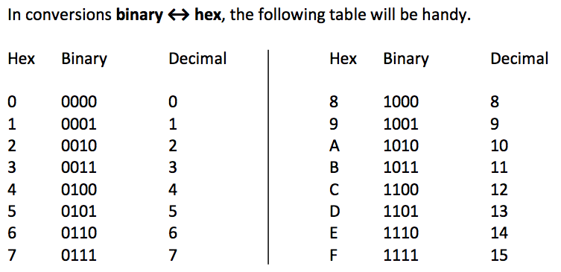
Helpful Table
(Can Only Be Used for Conversions Binary ←→ Hex)

Slide 31
Convert Base 8 to Base 2
The nibble approach (each octal digit = group of 3 bits)
(4517)₈ = (100101001111)₂
Base 8 | 4 | 5 | 1 | 7
Base 2 | 100 | 101 | 001 | 111

Slide 32
Convert Base 2 to Base 8
(101111101001100001)₂ = ( )₈
  Use the nibble approach (in reverse)
  For unsigned integers you start from the right and create groups of 3 bits
(101|111|101|001|100|001)₂
  Pad left with zeros to make the left most group a 3-bit group – not necessary in this case
(101|111|101|001|100|001)₂
  Translate each 3-bit group to the appropriate octal symbol
( 5 | 7 | 5 | 1 | 4 | 1 )₈
= (575141)₈

Slide 33
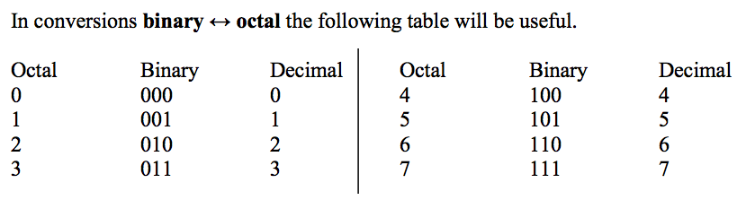
Helpful Table
(Can Only Be Used for Conversions of Binary ←→ Octal)

Slide 34
Convert Base 16 to Base 8
  Convert Base 16 to Base 2 then regroup the bits into groups of 3 bits to translate to Base 8
  (AE43)₁₆ = ( )₈
  Translate Base 16 to Base 2 (can use the binary ←→ hex table)
  ( A E 4 3 )₁₆
  (1010 1110 0100 0011)₂
  Regroup (starting from the right) the bits into 3-bit groups
  (1 010 111 001 000 011) ₂
  Pad the left with zeros to make the leftmost group 3 bits
  (001 010 111 001 000 011)₂
  Translate Base 2 to Base 8
  ( 1 2 7 1 0 3)₈ = (127103)₈

Slide 35
Convert Base 8 to Base 16
  Convert Base 8 to Base 2 then regroup the bits into groups of 4 bits to translate to Base 16
  (45176)₈ = ( )₁₆
  Translate Base 8 to Base 2 (can use the binary ←→ octal table)
  ( 4 5 1 7 6 )₈
  (100 101 001 111 110)₂
  Regroup (starting from the right) the bits into 4-bit groups
  (100 1010 0111 1110) ₂
  Pad the left with zeros to make the leftmost group 4 bits
  (0100 1010 0111 1110)₂
  Translate Base 2 to Base 16
  ( 4 A 7 E )₁₆ = (4A7E)₁₆

Slide 36
Keeping Track of the Bits
(Let’s Think About the Binary System)
Bits (binary digits – 0 or 1) are commonly stored and manipulated in groups
  8 bits = 1 byte
    Range: [0,2⁸-1]=[0…255] or 256 unique patterns
  2 bytes (16 bits) = half word (in many systems)
    Range: [0,2¹⁶-1]=[0…65535] or 65,536 unique patterns
  4 bytes (32 bits) = 1 word
    Range: [0,2³²-1]=[0…4294967295] or over 4 billion unique patterns
  8 bytes (64 bits) = double word
    Range: [0,2⁶⁴-1]=[0…18446744073709599999] or a lot of patterns!
Number of bits used in calculations
  Affects accuracy of results
  Limits size and range of numbers manipulated by the computer

Slide 37
Why Does This Matter?
(A Simple Programming Example)
Consider the following C++ pseudocode
  What is the problem?
  unsigned short int counter;
  counter=0;
  while (counter <= 70000) {
        //do something
  counter=counter+1;
  }

Slide 38
The Problem…
The problem with the code on the previous slide is
  The declaration unsigned short int counter will allocate to the variable counter 2 bytes only
  Therefore, the variable can store numbers within the range [0…65535] only
  The condition counter <=70000, assumes that the variable counter will eventually reach 70001, and the loop will end; but, it will never happen
  As a result, the program will work incorrectly
  It will be caught in an endless loop because when the variable counter reaches 65535 [or as the computer sees it – (1111 1111)₂], it will be initialized back to 0 [or (0000 0000)₂ ]
To fix the problem
  Change the declaration statement to unsigned int counter
  Now, 4 bytes have been allocated to the variable counter allowing the variable to store the larger number since it has a bigger range: [0…4294967295]
  As a result, the program will work correctly

Slide 39
Why Does This Matter?
(A Real-World Example: Therac-25 Accidents)
What was Therac-25?
  Released in 1983
  Computerized radiation therapy machine used to treat cancer patients
    Electron beam treatment vs. X-ray beam treatment
Who developed it?
  Atomic Energy of Canada, Ltd and GCR (French-based company)
What were the key advances of it over its predecessors (Therac-6 and Therac-20)?
  Move to more complete software-based control
    Faster set-up
      More time to speak with patients before and after treatments
      More patients could be treated each day
    Safety checks were now controlled by software (instead of mechanical interlocks)

Slide 40
Therac-25 Accidents
(What Happened?)
Massively overdosed patients at least 6 times (3 died, 3 seriously disabled)
  June 1985 (Linda Knight, 61 - Marietta, GA)
    Received 20,000 rads instead of 200!
      Radiation burns (scars) on her breast and clavicle area
      Had to have her breast removed
      Lost use of her arm and shoulder
      Constant pain
  July 1985 (Donna Gartner, 40 - Hamilton, ONT)
    Received 15,000 rads instead of 500!
      Radiation burns (scars) on her hip area
      Constant pain and swelling
      Required hip replacement
  December 1985 (Janis Tilman - Yakima, WA)
    Another overdose
      Radiation burns (scars) on her hip area
      Chronic skin ulcer, constant hip pain
      Required surgery and skin grafts (but still left with disabilities and scarring)

Slide 41
Therac-25 Accidents
(What Happened?)
Massively overdosed patients at least 6 times (3 died, 3 seriously disabled)
  March 1986 (Isaac Dahl, 33 - Tyler, TX)
    Another overdose
      Lost use of his arm and legs
      Constant pain and vomiting
      Lesion on his left lung
      Died from the radiation overdose
  April 1986 (Daniel McCarthy - Tyler, TX)
    Died from radiation overdose
  January 1987 (Anders Engman - Yakima, WA)
    Died from radiation overdose
Several surviving victims (and families of surviving victims) filed lawsuits in U.S. courts against the manufacurers
  All lawsuits were settled out of court

Slide 42
Therac-25 Accidents
(Why Did This Happen?)
The Problems
  Simple programming errors
    The one byte problem with the SET UP TEST procedure/routine in the code
  Inadequate safety engineering
    Ignored the software risks (almost no unit or integration testing at all)
    Operators were told it was impossible to overdose a patient
  Poor user interface design
    Complicated sequence, poor feedback, bad error messaging and recovery
  Lax culture of safety in the manufacturing co.
  Problems were not reported quickly to manufacturer or FDA

Slide 43
Important Note
(You Will See This on Test 1)
1 KB = 1,024 bytes
1 MB = 1,024 KB = (1,024)(1,024) = 1,048,576 bytes
1 GB = 1,024 MB = (1,024)³ = bytes = 1,073,741,824 bytes
1 TB = 1,024 GB = (1,024)⁴ bytes = …
1 PB = 1,024 TB – more than 10¹⁵ bytes
… you get the idea!

Slide 44
Summary
(So Far)
We know how to represent unsigned, positive integers in four different number systems and how to convert them from one system to another
We saw that the octal or hexadecimal systems are more convenient to use than the binary one because fewer digits are required to represent a number
  (0101|1101)₂= (5D)₁₆
  (01|011|101)₂= (135)₈
4 bits can represent 2⁴=16 different patterns → range is [0,2⁴-1]=[0,15]
  Smallest value = (0000)₂=(0)₁₀ and largest value = (1111)₂=(15)₁₀
8 bits can represent 2⁸=256 different patterns → range is [0,2⁸-1]=[0,255]
  Smallest value = (0000 0000)₂=(0)₁₀ and largest value = (1111 1111)₂=(255)₁₀
n bits can represent 2^{n} unique patterns → The range is [0,2^{n}-1]
  We saw a few reasons why this matters to programmers

Slide 45
Next Time
Positional number systems (continued)
  Read: Englander (Ch. 3, skip section 3.3)
  Get started on HW 1
    You can work in teams
  ICA 1
    Make sure to attend class so that you can complete and submit the In-Class Activity

Slide 46
Fractions
Number point or radix point
  Decimal point in base 10
  Binary point in base 2
  Octal point in base 8
  Hex point in base 16
May not be an exact relationship between fractional numbers in different number bases
  Exact conversion may be impossible, such as in the case of (1/3)₁₀ or 0.3333333₁₀…
  But (1/3)₁₀ can be represented exactly in Base 3 → 0.1₃
  Put another way, 0.1₃ cannot convert exactly to Base 10

Slide 47
Fractions
Move the number point one place to the right
  Effect: multiplies the number by the base number
  Example: 139.0₁₀ 1390₁₀
    1390₁₀ is ten times bigger
  Example: 10011.0₂ 100110₂
    100110₂ is two times bigger (38₁₀ vs. 19₁₀)
  Example: A1.0₁₆ A10₁₆
    A10₁₆ is 16 times bigger (161₁₀ vs. 2576₁₀)
Move the number point one place to the left
  Effect: divides the number by the base number
  Example: 139.0₁₀ 13.9₁₀

Slide 48
Fractions
(Convert to Base 10)
(0.2589)₁₀ = 2 x 10⁻¹ + 5 x 10⁻² + 8 x 10⁻³ + 9 x 10⁻⁴
Place | 10⁻¹ | 10⁻² | 10⁻³ | 10⁻⁴
Value | 1/10 | 1/100 | 1/1000 | 1/10000
Evaluate | 2 x 1/10 | 5 x 1/100 | 8 x 1/1000 | 9 x1/1000
Sum | .2 | .05 | .008 | .0009
.101011₂ = 1*2⁻¹ + 0*2⁻² + 1*2⁻³ + 0*2⁻⁴ + 1*2⁻⁵ + 1*2⁻⁶
= (0.671875)₁₀
Place | 2⁻¹ | 2⁻² | 2⁻³ | 2⁻⁴ | 2⁻⁵ | 2⁻⁶
Value | 1/2 | 1/4 | 1/8 | 1/16 | 1/32 | 1/64
Evaluate | 1 x 1/2 | 0 x 1/4 | 1x 1/8 | 0 x 1/16 | 1 x 1/32 | 1 x 1/64
Sum | 0.5 | 0.0 | 0.125 | 0.0 | 0.03125 | 0.015625
For numbers to the right of the number point (“.”) successive digits have values: 1/B, 1/B², 1/B³, … OR B⁻¹, B⁻², B⁻³, …

Slide 49
Fractions
(Convert to Base 10)
(0.D2)₁₆ = 13(16⁻¹) + 2(16⁻²)
= (0.8203125)₁₀
Place | 16⁻¹ | 16⁻²
Value | 1/16 | 1/256
Evaluate | 13 x 1/16 | 2 x 1/256
Sum | .8125 | .0078125
(0.627)₈ = 6(8⁻¹) + 2(8⁻²) + 7(8⁻³)
= (0.794921875)₁₀
Place | 8⁻¹ | 8⁻² | 8⁻³
Value | 1/8 | 1/64 | 1/512
Evaluate | 6 x 1/8 | 2 x 1/64 | 7x 1/512
Sum | .75 | .03125 | .013671875

Slide 50
Fractions
(Convert from Base 10 to Base 2)
Base 10 | (0.828125)₁₀
 | IP | R
.828125 * 2) | 1 | .656250 | MSD (2⁻¹)
.656250 * 2) | 1 | .312500
.3125 * 2) | 0 | .6250
.6250 * 2) | 1 | .2500
.2500 * 2) | 0 | .50
.5000 * 2) | 1 | .00 | LSD (2⁻⁶)
Base 2 | (0.110101)₂
Integer Product
Check to make sure this is correct!

Slide 51
Fractions
(Convert from Base 10 to Base 8)
Base 10 | (0.2)₁₀
 | IP | R
.2 * 8) | 1 | .6 MSP (8⁻¹)
.6 * 8) | 4 | .8
.8 * 8) | 6 | .4
.4 * 8) | 3 | .2
.2 * 8) | 1 | .6
.6 * 8) | 4 | .8 LSP (8⁻⁶)
… | … | …
Base 8 |  | (0.14631463…)₈
This is a repeating fraction – conversion does not come to closure
The digits “1463” will repeat endlessly

Slide 52
Fractions
(Convert from Base 10 to Base 16)
Base 10 | (0.96875)₁₀
 | IP | R
.96875 * 16) | 15 | .5
.5 * 16) | 8 | .0
Base 16 | (0.F8)₁₆

Slide 53
Fractions
(Convert Base 2 to Base 16 Via Grouping)
(0.10111)₂ = ( )₁₆
  Use the nibble approach (in reverse)
  For fractions you start from the left and create groups of 4 bits
(.1011|1)₂
  Pad right with zeros to make the rightmost group a 4-bit group
(.1011|1000)₂
  Now translate each 4-bit group to the appropriate hex symbol
(. B | 8 )₁₆
= (.B8)₁₆

Slide 54
Fractions
(Convert Base 2 to Base 8 Via Grouping)
(0.10111)₂ = ( )₈
  Use the nibble approach (in reverse)
  For fractions you start from the left and create groups of 3 bits
(.101|11)₂
  Pad right with zeros to make the rightmost group a 3-bit group
(.101|110)₂
  Now translate each 3-bit group to the appropriate octal symbol
(. 5 | 6 )₈
= (.56)₈

Slide 55
Fractions
(Convert from Base 16 to Base 8 Via Grouping)
(.D4)₁₆ = ( )₈
  Convert to Binary via grouping (can use the table) of 4 bits
(.1101|0100)₂
  Regroup (starting from the left) the bits into 3-bit groups
(.110|101|00)₂
  Pad the right with zeros to make the rightmost group 3 bits
(.110|101|000)₂
  Now translate each 3-bit group to the appropriate octal symbol
(. 6 | 5 | 0 )₈ = (.65)₈

Slide 56
Fractions
(Convert from Base 8 to Base 16 Via Grouping)
(.65)₈ = ( )₁₆
  Convert to Binary via grouping (can use the table) of 3 bits
(.110|101)₂
  Regroup (starting from the left) the bits into 4-bit groups
(.1101|01)₂
  Pad the right with zeros to make the rightmost group 4 bits
(.1101|0100)₂
  Now translate each 4-bit group to the appropriate hex symbol
(. D | 4 )₁₆ = (.D4)₁₆

Slide 57
Mixed Number Conversion
Integer and fractional parts must be converted separately
Consider the following decimal real number
(20.75)₁₀=2(10¹) + 0(10⁰) + 7(10⁻¹) + 5(10⁻²)
integer part fraction
Decimal → Binary
(20.75)₁₀ = ( )₂
  We deal with the integer part and fraction separately

Slide 58
Decimal → Binary
(20.75₁₀ – Integer Part)
Base 10 | (20)₁₀
 | IQ | R
20 / 2 ) | 10 | ( 0 Least significant bit
10 / 2 ) | 5 | ( 0
5 / 2 ) | 2 | ( 1
2 / 2 ) | 1 | ( 0
1 / 2 ) | 0 | ( 1 Most significant bit
Base 2 |  | (10100)₂

Slide 59
Decimal → Binary
(20.75₁₀ – Fraction Part)
Base 10 | (.75)₁₀
 | IP | R
.75 * 2 ) | 1 | .50
.5 * 2 ) | 1 | .00
Base 2 | (.11)₂

Slide 60
Decimal → Binary
(20.75₁₀)
Integer part: (10100)₂ – see previous slides
Fraction part: (.11)₂ – see previous slides
(20.75)₁₀ = (10100.11)₂
And conversion of real numbers between other bases is also possible through the methods we have already presented
  But let’s go through 1 more example just for fun

Slide 61
Decimal → Hex
(20.75₁₀)
(20.75)₁₀
  Convert to binary
(20.75)₁₀ = (10100.11)₂ – we did this earlier, see previous slides
  Group the integer part in 4-bit groups (starting from the right)
  Group the fraction part in 4-bit groups (starting from the left)
(1|0100.11)₂
  Pad the left with zeros (for the integer side)
  Pad the right with zeros (for the fraction side)
(0001|0100.1100)₂
  Convert each 4-bit group into the appropriate hex symbol
(1|4.C)₁₆ = (14.C)₁₆

Slide 62
Summary
(Fractions)
We know how to represent unsigned, real/floating point numbers (i.e., fractions) and mixed numbers in four different number systems and how to convert them from one system to another
Many real numbers are stored in the computer in their approximate form because many decimal fractions cannot convert exactly to a binary value

Slide 63
Next Time
Data Formats
  Read: Englander (Ch. 4)
Other reminders
  Complete Homework Assignment 1
  Some advice
    For short essay questions, use bullet points to highlight your answers and avoid saying unnecessary things; just get to the point
    For calculations, show all of your work; make sure your work is clear and organized

Slide 64
Binary Arithmetic
+ | 0 | 1
0 | 0 | 1
1 | 1 | 10
1 | 1 | 1 | 1 | 1
 | 1 | 1 | 0 | 1 | 1 | 0 | 1
+ |  | 1 | 1 | 0 | 1 | 1 | 0
1 | 0 | 1 | 0 | 0 | 0 | 1 | 1

Slide 65
Stop Recording

